Slide 1
第一课: 热身
九年级–使用数据序列的Python编程
Notes:
Resources are updated regularly - the latest version is available at: the-cc.io/curriculum.
This resource is licensed by the Raspberry Pi Foundation under a Creative Commons Attribution-NonCommercial-ShareAlike 4.0 International license. To view a copy of this license, visit, see creativecommons.org/licenses/by-nc-sa/4.0/.

Slide 2
开始活动
任务
input
print
while
if
=
重复执行动作
显示在屏幕上
检查条件，以选择要执行的操作
从键盘读取
给变量赋值

Slide 3
开始活动
任务
input
print
while
if
=
重复执行动作
显示在屏幕上
检查条件，以选择要执行的操作
从键盘读取
给变量赋值

Slide 4
开始活动
练习
当这个程序执行时，用户在键盘上输入12和2。
问题
屏幕上会显示什么?
2 + 12 / 2
13
7
8
1
2
3
4
a = int(input())
b = int(input())
avg = b + a / 2
print(avg)
记住运算符优先级规则:除后加。

Slide 5
开始活动
练习
1
2
3
4
5
6
a = int(input())
b = int(input())
max = a
if b > max:
max = b
print(max)
当这个程序执行时，用户在键盘上输入12和2。
问题
屏幕上会显示什么?
什么都不显示
2
12
max
第4行中的条件将求值为False。第6行的打印是缩进的:它是if块的一部分，所以它不会被执行。

Slide 6
开始活动
辨别
1
2
3
4
5
6
7
8
a = int(input())
b = int(input())
avg = b + a / 2
print(avg)
max = a
if b > max:
max = b
print(max)
变量
赋值语句
算术表达式
布尔表达式
不能执行的语句块

Slide 7

开始活动
识别: 答案
a, b, avg, max
1
2
3
4
5
6
7
8
a = int(input())
b = int(input())
avg = b + a / 2
print(avg)
max = a
if b > max:
max = b
print(max)
变量
赋值语句
算术表达式
布尔表达式(状态)
不能执行的语句块

Slide 8

学习目标
在前面的单元中，你…
在本单元中，你将……
使用基于文本的编程语言(Python)创建的程序涉及:
变量、运算符和表达式序列、选择和迭代
使用Python开发的程序还涉及:
列表和字符串
print("Hello Python!")
new_stuff = ["lists",
"strings"]
Notes:
Logo: https://www.python.org/community/logos/

Slide 9

目标
在这节课中，你将:
温习Python技能 演练或编写显示消息、接收键盘输入以及在赋值语句中使用算术表达式的程序
使用选择(if- if-else)语句来控制程序执行的流程
创建列表并访问其中的项目

Slide 10

活动 1
You will be using pair programming, with each member in a pair taking on a specific role:
Driver
Control the keyboard and mouse
Navigator
Provide support and instructions
You will alternate between roles.

Slide 11

Activity 1
Selection recap
if :
elif :
else:
You need a selection structure. (if-elif-else) when there are multiple branches and your program needs to select which one of them to follow.
condition
block of statements
condition
block of statements
You can use none, one, or multiple elif–blocks.
You can use none, or one else–block.
block of statements

Slide 12

Activity 1
Selection recap
1
2
print("What day is it today?")
day = int(input())
Let’s extend this program together, to check the day and display whether it’s a weekday on not.
Note: The program uses an integer for each day of the week, ranging from 0 for Monday to 6 for Sunday.
Live coding (the-cc.io/py-week-0)

Slide 13
Activity 1
Selection recap: After the live coding session
1
2
3
4
5
6
print("What day is it today?")
day = int(input())
if day <= 4:
print("It’s a weekday")
else:
print("It’s the weekend!")
We created a program to check the day and display whether it’s a weekday on not.
Note: The program uses an integer for each day of the week, ranging from 0 for Monday to 6 for Sunday.

Slide 14

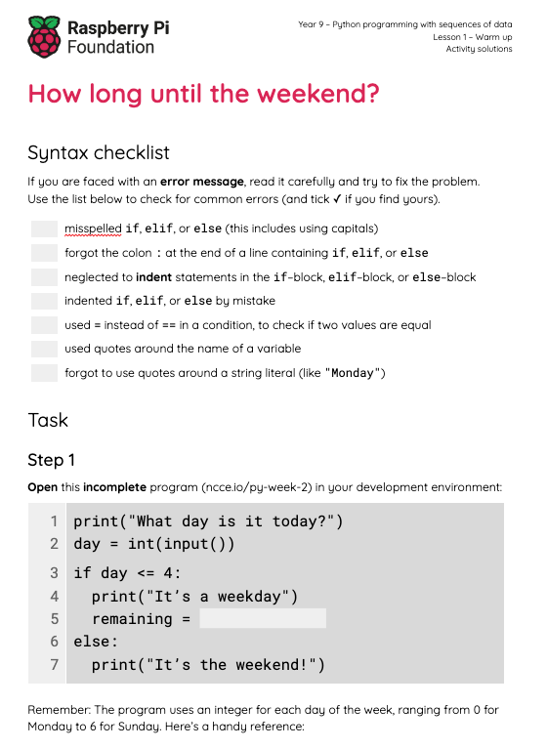
Activity 2
How long until the weekend?
Complete the task in your worksheet to extend your current program even further.

Slide 15
Activity 2
How long until the weekend? Solution
1
2
3
4
5
6
7
8
print("What day is it today?")
day = int(input())
if day < 4:
print("It’s a weekday")
remaining = 5 - day
print(remaining, "days until the weekend")
else:
print("It’s the weekend!")
Remaining days .
(steps 2-3)

Slide 16
Activity 2
How long until the weekend? Solution
1
2
3
4
5
6
7
8
9
10
11
print("What day is it today?")
day = int(input())
if day < 4:
print("It’s a weekday")
remaining = 5 - day
print(remaining, "days until the weekend")
elif day == 4:
print("It’s Friday")
print("Just a day left until the weekend")
else:
print("It’s the weekend!")
Handle Friday as a special case .
(step 4)

Slide 17
Activity 2
How long until the weekend? Solution
1
2
3
4
5
6
7
8
9
10
11
from datetime import datetime
day = datetime.now().weekday()
if day < 4:
print("It’s a weekday")
remaining = 5 - day
print(remaining, "days until the weekend")
elif day == 4:
print("It’s Friday")
print("Just a day left until the weekend")
else:
print("It’s the weekend!")
Retrieve the current day of the week
(explorer task)

Slide 18
Activity 3
A list of names
1
2
3
4
days = ["Monday", "Tuesday",
"Wednesday", "Thursday",
"Friday", "Saturday",
"Sunday"]
The names for the days of the week can be stored in a list.
Syntax: A comma-separated list of values (items), in square brackets.
In this example, the list items are string literals (i.e. pieces of text), so they need to be in quotation marks.

Slide 19
Activity 3
A list of names
1
2
3
4
days = ["Monday", "Tuesday",
"Wednesday", "Thursday",
"Friday", "Saturday",
"Sunday"]
A list is a kind of data structure.
Data structures are organised collections of data.
In the case of lists, data is organised in a sequence, with each item having a unique index, denoting its position in the list.

Slide 20
Activity 3
A list of names
1
2
3
4
days = ["Monday", "Tuesday",
"Wednesday", "Thursday",
"Friday", "Saturday",
"Sunday"]
days
0 | "Monday"
1 | "Tuesday"
2 | "Wednesday"
3 | "Thursday"
4 | "Friday"
5 | "Saturday"
6 | "Sunday"
When the program is executed, this is what the list will look like in memory.

Slide 21

Activity 3
A list of names
1
2
3
4
days = ["Monday", "Tuesday",
"Wednesday", "Thursday",
"Friday", "Saturday",
"Sunday"]
days
0 | "Monday"
1 | "Tuesday"
2 | "Wednesday"
3 | "Thursday"
4 | "Friday"
5 | "Saturday"
6 | "Sunday"
Note: List item numbering starts from 0 (zero-based).
Each item has a unique index, denoting its position in the list.

Slide 22
Activity 3
A number for a name
1
2
3
4
5
days = ["Monday", "Tuesday",
"Wednesday", "Thursday",
"Friday", "Saturday",
"Sunday"]
print(days[0])
days
0 | "Monday"
1 | "Tuesday"
2 | "Wednesday"
3 | "Thursday"
4 | "Friday"
5 | "Saturday"
6 | "Sunday"
When this program is executed, what will be displayed on the screen?
Answer: Monday

Slide 23
Activity 3
A number for a name
1
2
3
4
5
days = ["Monday", "Tuesday",
"Wednesday", "Thursday",
"Friday", "Saturday",
"Sunday"]
print(days[1])
days
0 | "Monday"
1 | "Tuesday"
2 | "Wednesday"
3 | "Thursday"
4 | "Friday"
5 | "Saturday"
6 | "Sunday"
When this program is executed, what will be displayed on the screen?
Answer: Tuesday

Slide 24
Activity 3
A number for a name
1
2
3
4
5
days = ["Monday", "Tuesday",
"Wednesday", "Thursday",
"Friday", "Saturday",
"Sunday"]
print(days[4])
days
0 | "Monday"
1 | "Tuesday"
2 | "Wednesday"
3 | "Thursday"
4 | "Friday"
5 | "Saturday"
6 | "Sunday"
When this program is executed, what will be displayed on the screen?
Answer: Friday

Slide 25
Activity 3
A number for a name
1
2
3
4
5
days = ["Monday", "Tuesday",
"Wednesday", "Thursday",
"Friday", "Saturday",
"Sunday"]
print(days[7])
days
0 | "Monday"
1 | "Tuesday"
2 | "Wednesday"
3 | "Thursday"
4 | "Friday"
5 | "Saturday"
6 | "Sunday"
When this program is executed, what will be displayed on the screen?
Answer: An IndexError will occur.

Slide 26
Activity 3
A number for a name
1
2
3
4
5
6
days = ["Monday", "Tuesday",
"Wednesday", "Thursday",
"Friday", "Saturday",
"Sunday"]
day = 3
print(days[day])
days
day
0 | "Monday"
1 | "Tuesday"
2 | "Wednesday"
3 | "Thursday"
4 | "Friday"
5 | "Saturday"
6 | "Sunday"
3
Expressions can be used to access item lists (as long as they evaluate to an integer).

Slide 27
Activity 3
A number for a name
1
2
3
4
5
6
days = ["Monday", "Tuesday",
"Wednesday", "Thursday",
"Friday", "Saturday",
"Sunday"]
day = 3
print(days[day])
days
day
0 | "Monday"
1 | "Tuesday"
2 | "Wednesday"
3 | "Thursday"
4 | "Friday"
5 | "Saturday"
6 | "Sunday"
3
3
When this program is executed, what will be displayed on the screen?
Answer: Thursday

Slide 28
Activity 3
A number for a name
1
2
3
4
5
6
days = ["Monday", "Tuesday",
"Wednesday", "Thursday",
"Friday", "Saturday",
"Sunday"]
day = 3
print(days[day-1])
days
day
0 | "Monday"
1 | "Tuesday"
2 | "Wednesday"
3 | "Thursday"
4 | "Friday"
5 | "Saturday"
6 | "Sunday"
3
2
When this program is executed, what will be displayed on the screen?
Answer: Wednesday

Slide 29
Activity 3
A number for a name
1
2
3
4
days = ["Monday", "Tuesday",
"Wednesday", "Thursday",
"Friday", "Saturday",
"Sunday"]
Examine an extended version (the-cc.io/py-week-5) of the previous program, which incorporates the list of days.

Slide 30
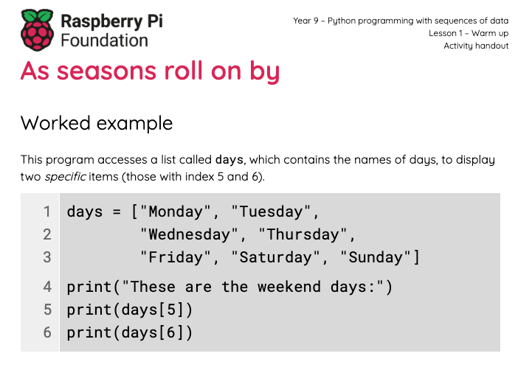
Activity 4
As seasons roll on by
Complete the tasks in your worksheet to explore lists and practise some more with selection.

Slide 31
Activity 4
As seasons roll on by: Solutions
1
2
3
4
5
6
7
8
9
months = ["January", "February",
"March", "April", "May",
"June", "July", "August",
"September", "October", "November",
"December"]
print("These are the summer months:")
print(months[5])
print(months[6])
print(months[7])
June has an index of 5.
July has an index of 6.
August has an index of 7.
All indices are shifted by 1, compared to the common numbering of months, because list item numbering is zero-based.

Slide 32
Activity 4
As seasons roll on by: Solutions
1
2
3
4
5
6
7
8
months = ["January", "February",
"March", "April", "May",
"June", "July", "August",
"September", "October", "November",
"December"]
print("What month is it? (1-12)")
month = int(input())
print("It is", months[month-1])
The month (provided by the user) is reduced by 1, before it is used as an index, because list item numbering is zero-based.

Slide 33
Activity 4
As seasons roll on by: Solutions
1
2
3
4
5
6
7
8
9
10
11
12
seasons = ["Winter", "Spring", "Summer", "Autumn"]
print("What month is it? (1-12)")
month = int(input())
if month <= 2 or month == 12:
season = 0
elif month <= 5:
season = 1
elif month <= 8:
season = 2
else:
season = 3
print("It is", seasons[season])
The condition that checks if this is a winter month is more complex, because the numbering for winter months is not consecutive.

Slide 34

Plenary
Lists of what?
In this lesson, you used lists that stored the names of days, months, and seasons.
What else do you think a program could store in a list?

Slide 35
Summary
In this lesson, you...
In the next lesson, you will...
Brushed up on your Python skills
Used selection (if-elif-else statements) to control the flow of program execution
Created lists and accessed their items
Perform operations on lists

